Slide 1
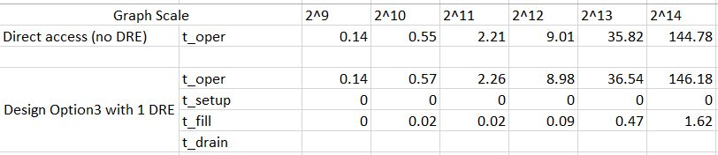
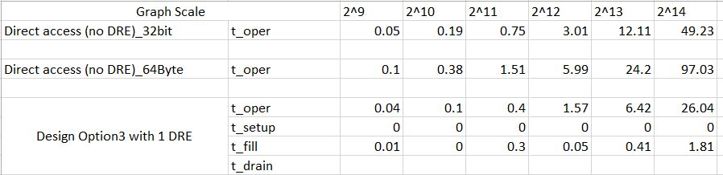
Update (Yu)
This week
Recollected performance statistics of image differencing on design option 3, changing 8-bit access to 64-Byte access
Maximum of PCI-Express packet size is 64-Byte
No Speedup
2X Speedup

Slide 2
Update (Yu)
This week
For random access, measure if the PCI-Express bandwidth has been saturated in baseline mode
DRE may could not get speedup, bottlenecked by saturated PCI-Express

Slide 3
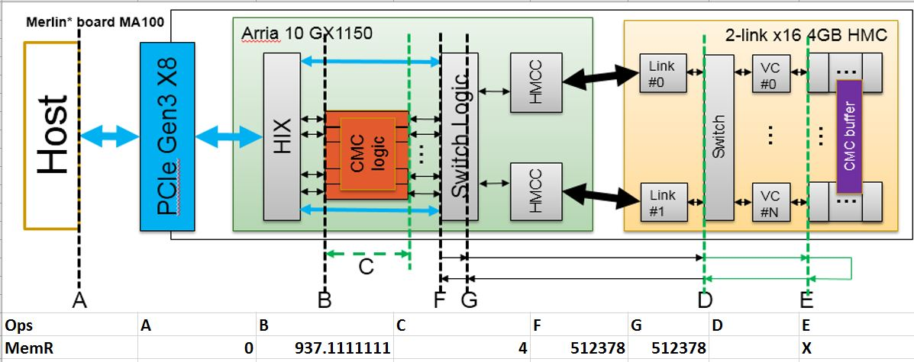
Update (Yu)

